Slide 1
SDJ2
Unit testing

Slide 2
Comment about connecting to a database from Java
See video in SEP2 itslearning page

Slide 3
Agenda
What is testing
Why even test?
Why a structured approach?
Breaking your program
What is unit testing?
Testing approaches?
Black and white box
Boundary analysis
Equivalence partitioning
Tool: JUnit 4
How to create a unit test
How to structure
Example: Testing a queue
What is a queue?
Example: Testing MVVM

Slide 4

https://www.space.com/20305-mars-rover-curiosity-safe-mode.html
https://www.space.com/23553-mars-rover-curiosity-software-glitch.html
Notes:
Links to how NASA messed up with their testing, and sent a robot to Mars which frequently broke down.
In August, 2012, Curiosity landed on Mars.

Slide 5
Testing
Students usually only test sunny cases
Verify your code works as expected
Both sunny and rainy scenarios
Verify your program can handle unexpected/illegal actions
What you can expect from your users

Slide 6

What is the purpose of testing?
“Program testing can be used to show
the presence of bugs,
but never to show their absence!”
- Edsger W. Dijkstra
Try to make your program fail!

Slide 7
Structured approach
1st semester:
Testing some code with a main method?
Clicking aimlessly around the GUI
What if you find an error. Then you fix it, but you don’t remember how you got it?
Sometimes colleagues will test your code.
Tests must be reproduceable

Slide 8


Slide 9
Agenda
What is testing
Why even test?
Why a structured approach?
Breaking your program
What is unit testing?
Testing approaches?
Black and white box
Boundary analysis
Equivalence partitioning
Tool: JUnit 4
How to create a unit test
How to structure
Example: Testing a queue
What is a queue?
Example: Testing MVVM

Slide 10
Different types of tests
Ib covers this. You’ll be doing this a lot in your SEP2
How to write test cases
Scenario testing
Testing a scenario/feature/user story. From user POV
Integration testing
Testing certain classes collaborate correctly
Testing integration of database, or client-server connection
Unit testing
Code that tests your code
Testing even smaller parts of the system, down to single methods.
Usually the more complicated logic
Quick example

Slide 11
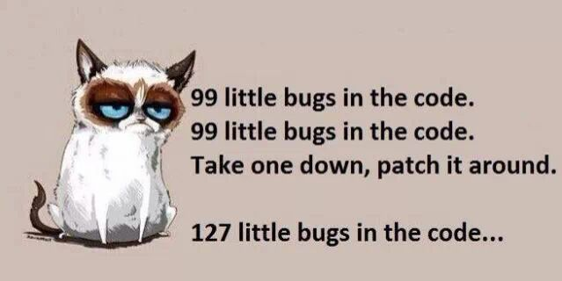
The huge benefit of unit tests
Whenever you change your program, you can just run your unit tests, to make sure that you didn’t break anything
A validation tool that runs in a few seconds

Slide 12
Agenda
What is testing
Why even test?
Why a structured approach?
Breaking your program
What is unit testing?
Testing approaches?
Black and white box
Boundary analysis
Equivalence partitioning
Tool: JUnit 4
How to create a unit test
How to structure
Example: Testing a queue
What is a queue?
Example: Testing MVVM

Slide 13
Testing approaches
Depending on the information available to you, there are two categories of tests:
White box and black box

Slide 14
White & Black box

Slide 15

Test categories
Black-box testing (from a users/testers point of view)
Follow requirements, documentation, specifications (all cases and exceptions)
No access to code -> you can’t see how it works “under the hood”
Give some input, get some output. No idea how it works
Some software

Slide 16

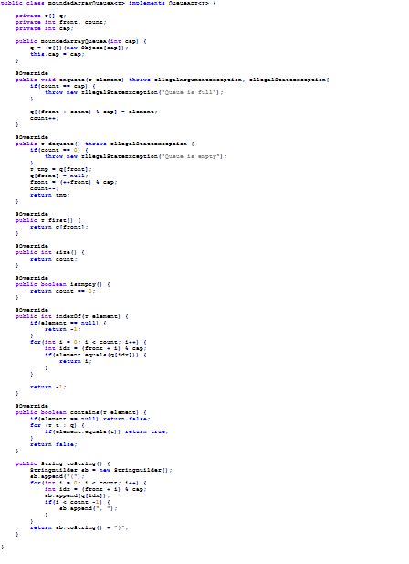
Test categories
White-box testing (from a programmers point of view)
Access to code, which can provide you with a lot of extra information

Slide 17
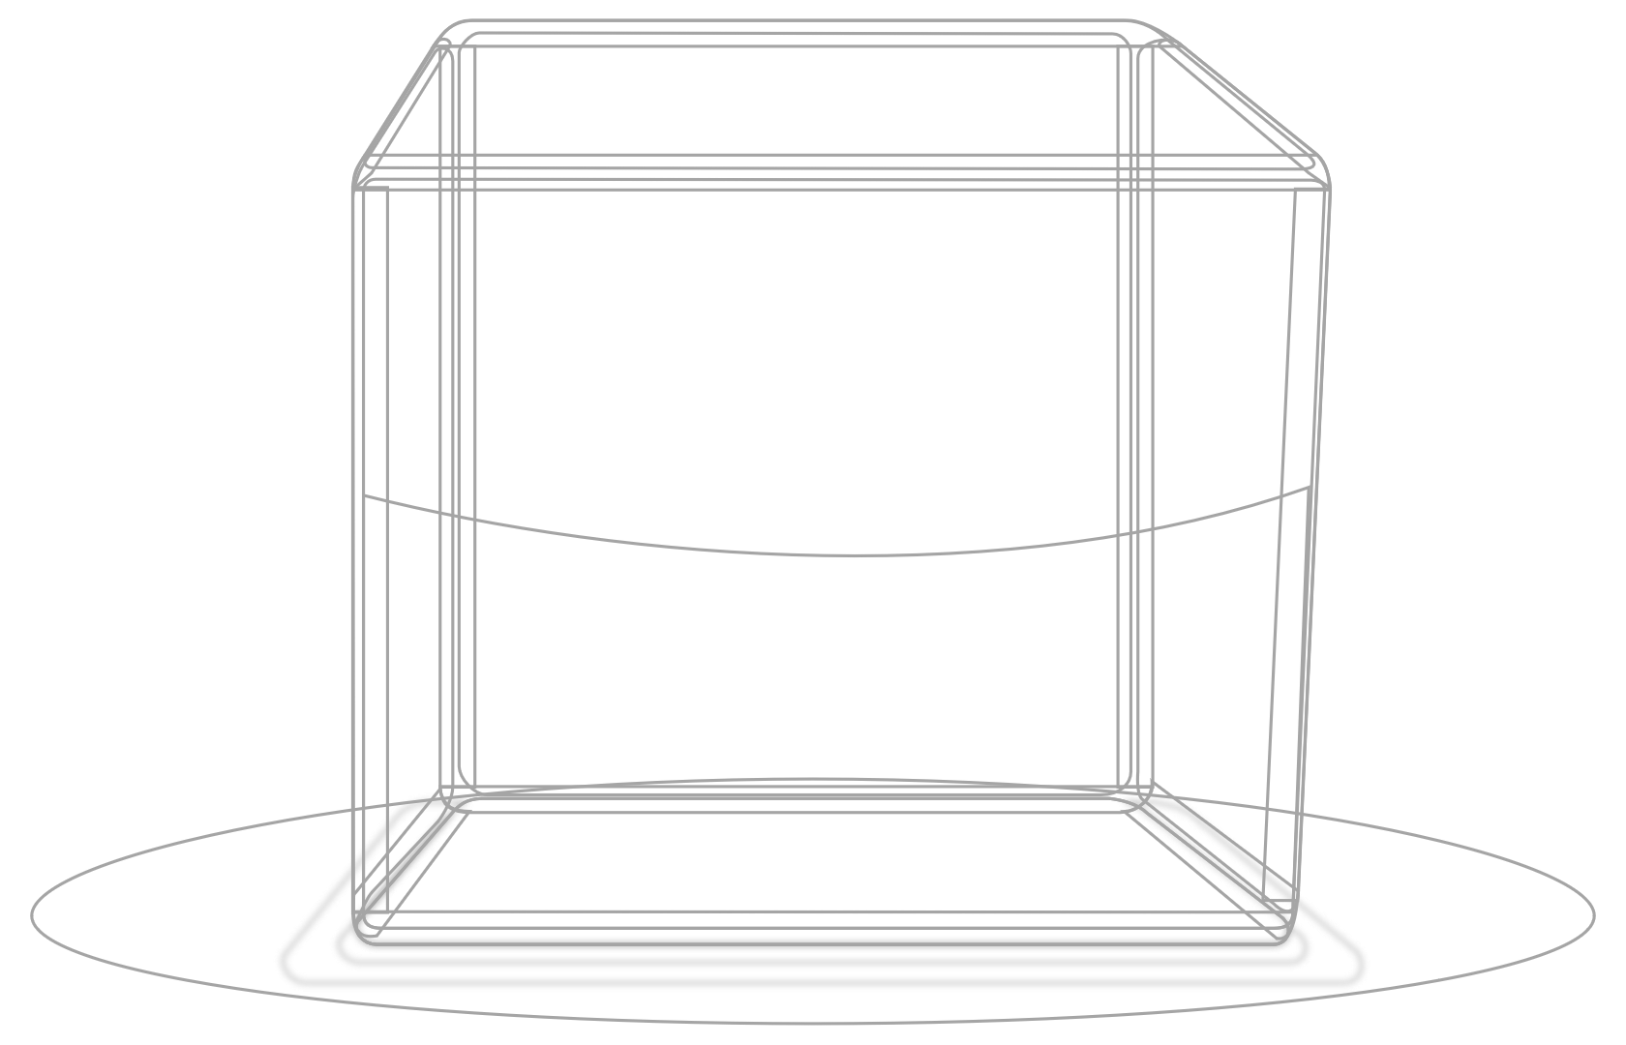
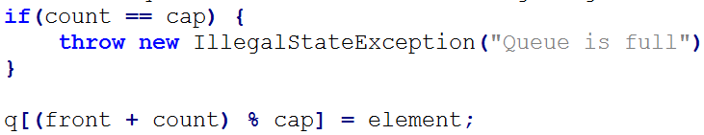
Test categories
White-box testing (from a programmers point of view)
Access to code, which can provide you with a lot of extra information
Follow the implementation (all methods, selections, if-statements, loops and exceptions)
Branch testing and condition/decision coverage

Slide 18
Test categories
White-box testing (from a programmers point of view)
Access to code, which can provide you with a lot of extra information
Follow the implementation (all methods, selections, if-statements, loops and exceptions)
Branch testing and condition/decision coverage

Slide 19
Black box:
Cannot see code
From a user point of view
Follow specification, requirements, documentation
White box:
Programmer point of view
Access to code

Slide 20


Slide 21
How do we approach testing a method?
If-statements and Loops -> branch testing
Some methods/functionality have “borders” in their behavior
We cannot test exhaustively, so we need some heuristics to select good cases
Boundary value analysis
Equivalence partitioning.
(video)
(description)

Slide 22
Boundary value analysis
Consider extreme ends like Start/End, Lower/Upper, Maximum/Minimum, Just Inside/Just Outside values are called boundary values and the testing is called "boundary testing".
The basic idea in boundary value testing is to select input variable values at their:
Minimum
Just above the minimum
A nominal value
Just below the maximum
Maximum

Slide 23
Boundary value analysis, Examples
Arraylist, empty vs non-empty
Webshop, ordering multiple items, valid input: 1-99. What happens with 0, or 100?
Restrictions for length of username: [3, 14] characters. What about usernames of 2 or 15 characters?
Inputting valid dates, months have 28/30/31 days, what happens if you select 30th of February?
What happens in your application if your search result is empty? Or you get more than the 50 results, your table is able to show?

Slide 24


Slide 25
Equivalence partitioning
Equivalence partitioning
For the List, do I need to create tests for adding 2 elements, 3, 4, 100, 546?
The behavior of a method is identical in most cases. If you can add 3 elements in the list, you would expect the 4th to be okay as well.
Equivalence partitioning is to cover all these cases with just a handful of sample tests.
Equivalence partitioning is important, because we cannot always realistically test every single case.

Slide 26
Same Examples
Arraylist, empty vs non-empty
Webshop, ordering multiple items, valid input: 1-99. Do I need to test for inputs 1->99? Or can I pick a few representatives?
Restrictions for length of username: [3, 14] characters. Do I need to test with usernames of lengths 3->14?
Inputting valid dates, months have 28/30/31 days. All should be good with days [1, 28]. No need to test all variations.
If you application’s search result table is set to 50, then whether you return 7, 11, 27 results, it should be the same.

Slide 27
Why equivalence and boundary?
This is used to reduce a very large number of test cases to manageable chunks.
Very clear guidelines on determining test cases without compromising on the effectiveness of testing.
Appropriate for calculation-intensive applications with a large number of variables/inputs

Slide 28
Agenda
What is testing
Why even test?
Why a structured approach?
Breaking your program
What is unit testing?
Testing approaches?
Black and white box
Boundary analysis
Equivalence partitioning
Tool: JUnit 4
How to create a unit test
How to structure
Example: Testing a queue
What is a queue?
Example: Testing MVVM

Slide 29
JUnit
A Java tool to write unit tests

Slide 30
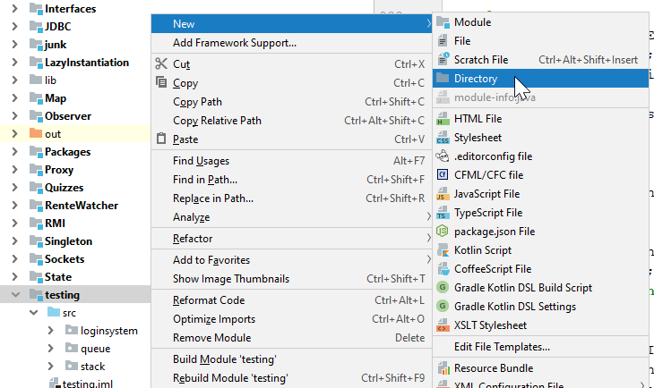
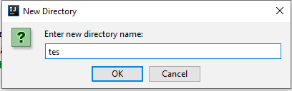
How to create, IntelliJ

Slide 31
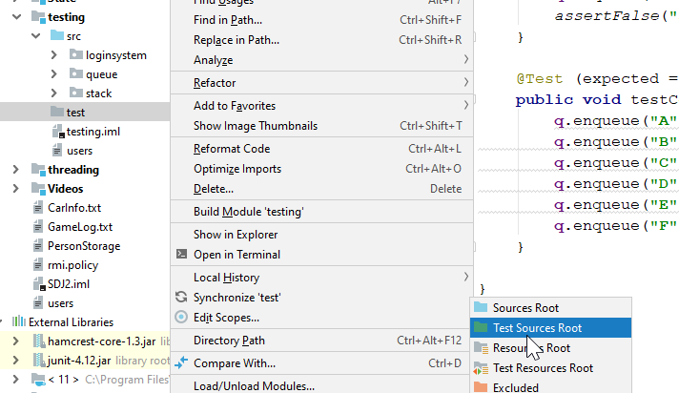
How to create, IntelliJ

Slide 32
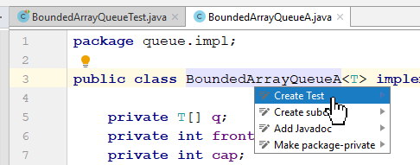
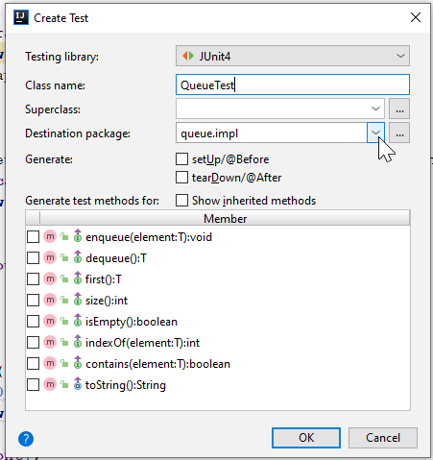
Open your class, put cursor on class name, alt+enter, Create Test
Important that you pick JUnit

Slide 33
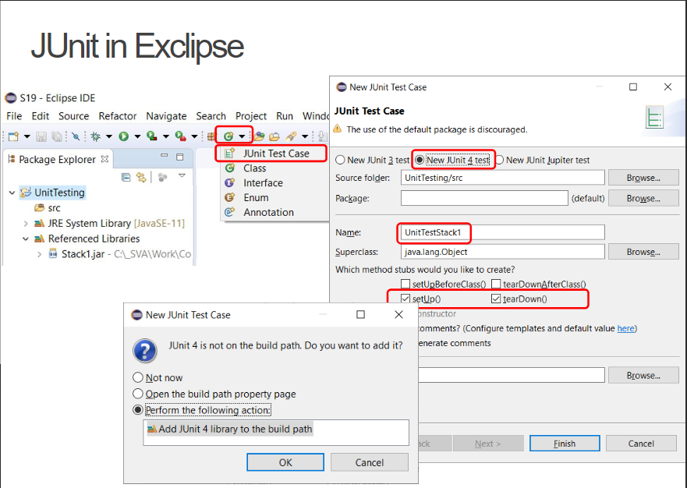

Slide 34
JUnit tools
Annotations
Specific methods

Slide 35
JUnit tools
@Before public void setup() { q = new BoundedArrayQueueA<>(5); } @After public void breakDown() { // Here I can delete/remove/clear stuff } @Test (expected = IllegalStateException.class) public void testEnqueue() { q.enqueue("A"); q.enqueue("B"); q.enqueue("C"); assertEquals(3, q.size()); q.enqueue("D"); q.enqueue("E"); assertTrue(q.contains("E")); assertEquals(5, q.size()); q.enqueue("F"); fail("Should not be able to push 6 elements with capacity 5"); }
More JUnit methods
More JUnit tutorial
Notes:
@Before -> this method is run before each test method
@After -> this method is run after each test method
@Test -> this method will be run as part of the testing
assertEquals -> takes two objects, if they are equal, this assertion passes and the test continues. If they are not equal, the test will fail here
assertTrue -> Similarly, if the exprections/variable here is true, the assertion passes. If it is false, the test fails
assertFalse -> Opposite of above
fail -> You can manually make your test fail. Sometimes, if you reach a part of the test, you want it to fail.
(expected = IllegalStateException.class) -> If this exception is thrown, then your test passes. If this exception is not thrown at any point in your test method, then your test fails.

Slide 36
How to structure JUnit tests
AAA
Arrange
Act
Assert
Test as little as possible!
Sometimes we can’t avoid testing more than one thing
No dependencies between tests, or on client-server, (database?)
The tests are run in random order
Stateless: create everything you need, and delete it again after each test
Using @Before and @After

Slide 37
Agenda
What is testing
Why even test?
Why a structured approach?
Breaking your program
What is unit testing?
Testing approaches?
Black and white box
Boundary analysis
Equivalence partitioning
Tool: JUnit 4
How to create a unit test
How to structure
Example: Testing a queue
What is a queue?
Example: Testing MVVM

Slide 38

What is a queue?
We’ll use it in the assignment
Enter and exit only at opposite ends of the line
You add (enqueue) new elements at one end
You take (dequeue) elements from the other end

Slide 39
T

Slide 40
Testing a bounded queue
<<interface>>
QueueADT
Test this
+ enqueue(element : T) : void
+ dequeue() : T
+ first() : T
+ indexOf(element : T) : int
+ isEmpty() : boolean
+ size() : int
+ contains(element T) : boolean
Notes:
A bounded queue is a queue where there is a maximum of allowed elements. Your standard ArrayList has no limit. But to make our tests interesting, we’ll test a queue with a limit to maximum number of elements

Slide 41
I have 2 versions:
Simple version is “straightforward”
Version 2 made for optimization, and more interesting tests

Slide 42
Let’s try the “enqueue” method
void enqueue (T element):
Adds an element to the back of the queue. If the element is null an IllegalArgumentException is thrown. If the capacity of the queue is reached, an IllegalStateException is thrown.

Slide 43
Let’s code a few Queue unit tests
*Clack*
*Click*
T

Slide 44


Slide 45
Agenda
What is testing
Why even test?
Why a structured approach?
Breaking your program
What is unit testing?
Testing approaches?
Black and white box
Boundary analysis
Equivalence partitioning
Tool: JUnit 4
How to create a unit test
How to structure
Example: Testing a queue
What is a queue?
Example: Testing MVVM

Slide 46
Benefit of MVVM structure
Because we’re separating GUI/view from the logic/data behind, it’s easier to unit test the logic.
Manual testing by clicking around in the GUI is super tedious
If I encounter a bug, and fix it, and I need to test I didn’t break anything, it’s even more super tedious
The plan:
Strip away unnecessary classes, unit test the VM and Model.

Slide 47
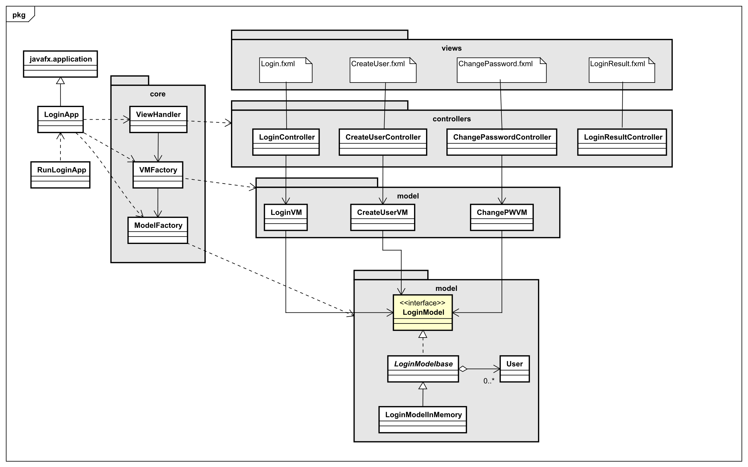
viewmodels
This one is only for my testing example. I doubt you’ll find use for it else where

Slide 48
Quick demo

Slide 49
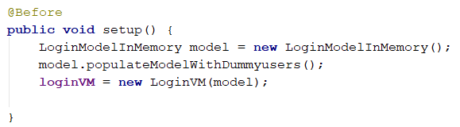
What we test:
I don’t need most of the classes in my MVVM setup, if I mainly want to test the logic through the view models

Slide 50
Testing
Can I log in with a valid login?
When creating a new user, there are a couple of requirements:
The username must:
Be between 4 (included) and 14 (included) characters
Not be empty
Not contain the hash character ‘#’
Be unique, a username cannot appear twice

Slide 51
Let’s code a few Queue unit tests
*Clack*
*Click*
T

Slide 53

Who’s here?

